Slide 1
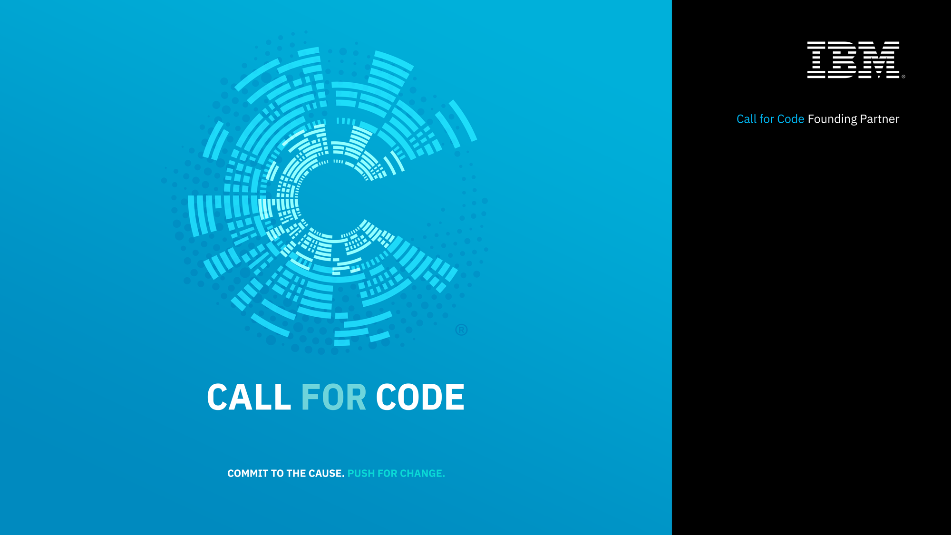

Slide 2

PLAN FOR TODAY
9:00 Kickoff
10:00 – 12:00 Team formation and ideation
12:00 Working lunch
12:00 – 4:00 Lightning code session
4:00 – 5:30 Team pitches & presentations

Slide 3
CALL FOR CODE DAY KICKOFF
Introductions and Logistics
What is Call for Code?
Use Cases and Code Pattern examples
Getting Started
Submissions and Judging

Slide 4
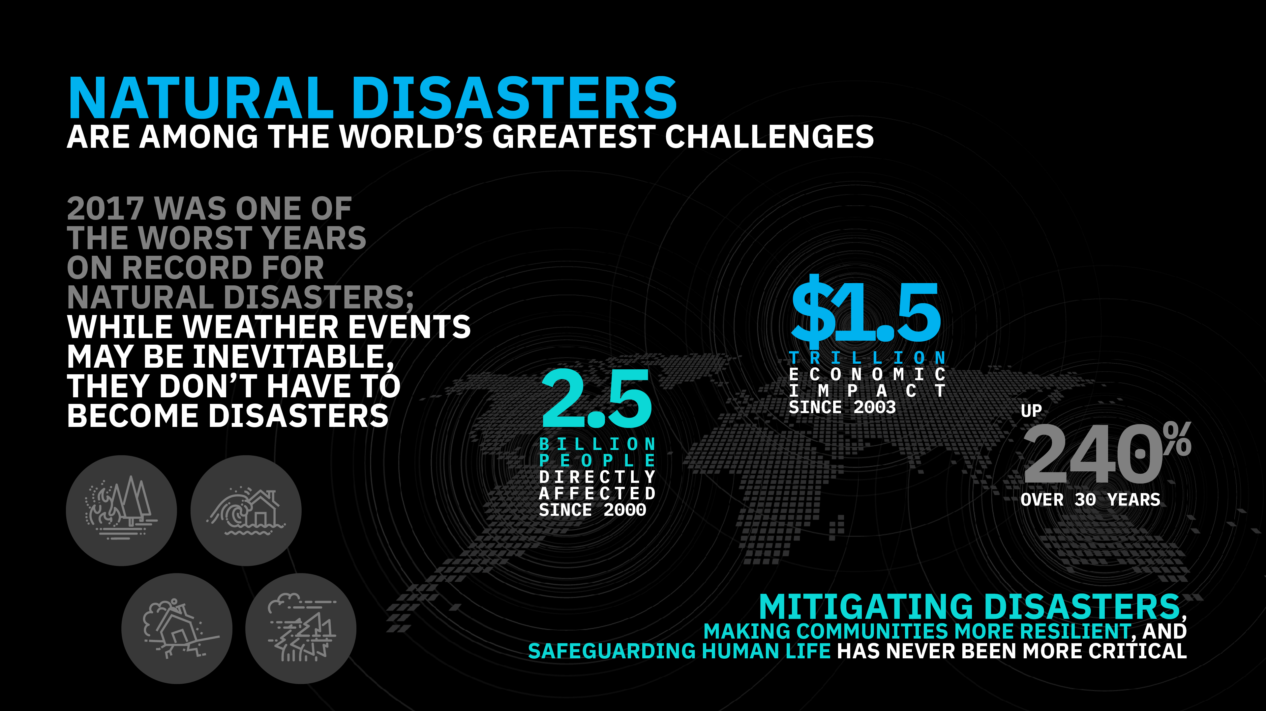
Notes:
Through our long history of working with the world’s developers, particularly in the open source community, we know their impact as the builders of modern business. We also know, through our long history of leading the industry to leverage technology for societal good, that developers can have a similar impact as the builders of a better society – both in ethical considerations for how technology is built and more directly in the use of their skills to address some of the most pressing problems of our modern world.

Slide 5
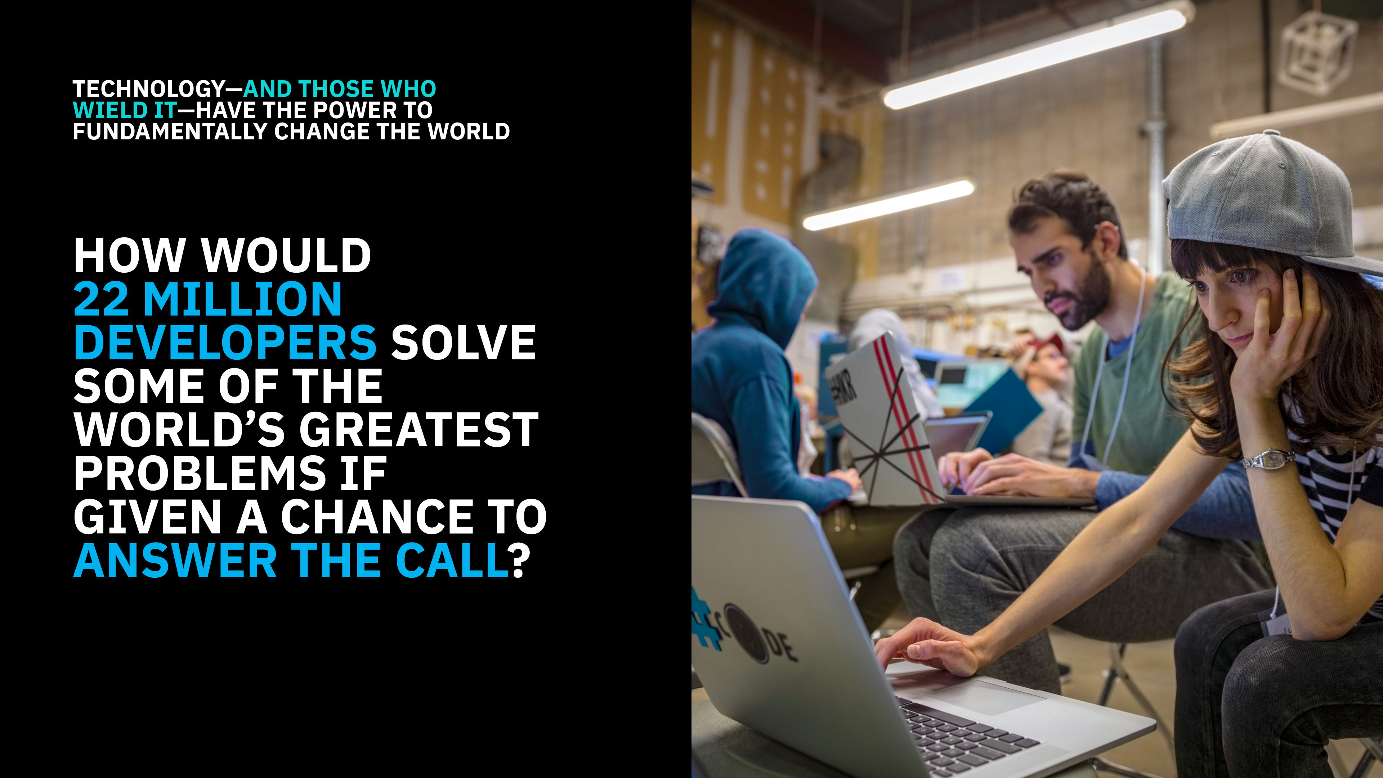

Slide 6

Call for Code inspires developers to solve pressing global problems with sustainable software solutions, delivering on their vast potential to do good.
Bringing together NGOs, academic institutions, enterprises, and startup developers to compete build effective disaster mitigation solutions, with a focus on health and well-being.
The American Red Cross, and the United Nations Office of Human Rights combine for the Call for Code Award to elevate the profile of developers.
The winning team in the IBM challenge will receive 50,000 BluePoints and be eligible to attend the Call for Code Award Event with a VIP pass.
Developers will jump-start their project with dedicated IBM Code Patterns, combined with optional enterprise technology to build projects over the course of three months.
IBM team project finalists will be judged by a team of executive leaders, with the winning team announced on w3.

Slide 7

CHALLENGE
Create solutions that significantly improve preparedness for natural disasters and relief when they hit in order to safeguard the health and well-being of communities.
Consider long-term, short-term, mid-crisis, and recovery timeframes.
UNITED NATIONS SENDAI FRAMEWORK: TARGETS AND PRIORITIES
RED CROSS STRATEGY 2020:
STRATEGIC AIMS
Notes:
The overall challenge scope is broad. Save lives by preparing communities for disaster, and helping them recover stronger.
The UN and Red Cross have frameworks available that can help guide you as to the priority areas where technology can help, as well as the targets they hope to achieve to measure success.
They can serve as roadmaps to help you solve the right problems.

Slide 8
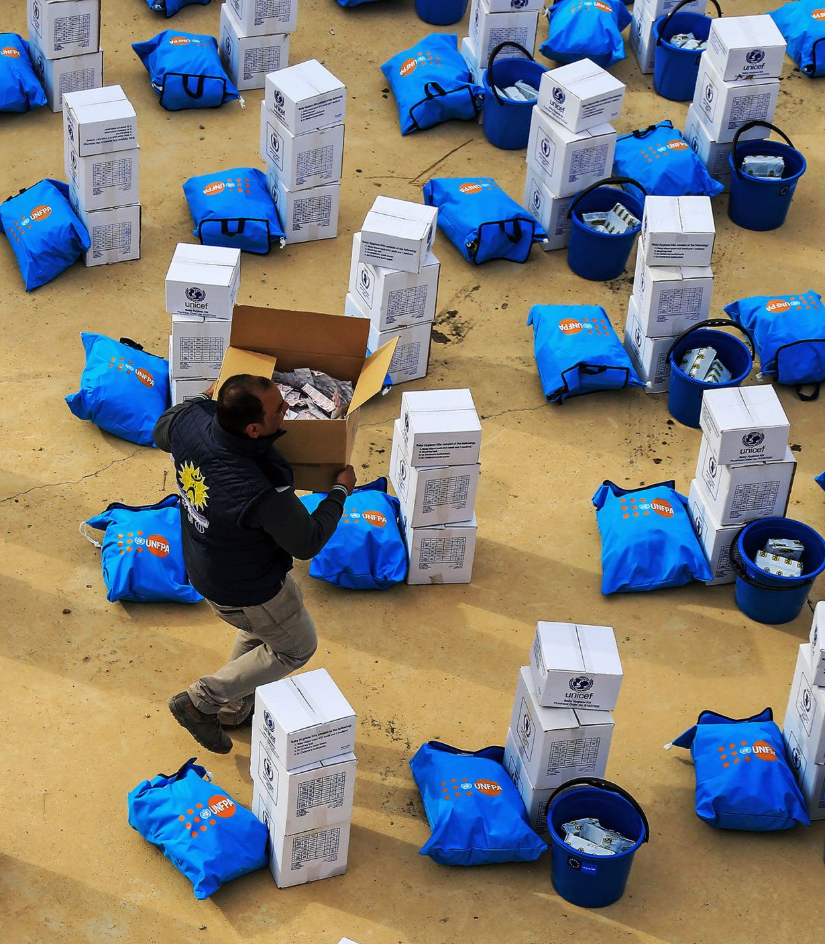
Code Patterns
Build a blockchain network
Deploy an asset-transfer app using blockchain
Create a real-time payments application
Track financial donations with blockchain
Automate business processes via blockchain events
Create financial applications using APIs on mainframe
Build resilient financial networks to execute secure transactions quickly
developer.ibm.com/callforcode/resources/financial-networks/

Slide 9

Code Patterns
Create a mobile written Hangul translation app
Analyze Twitter handles and hashtags for sentiment and content
Deploy a serverless multilingual conference room
Create an app to perform intelligent searches on data
Translate
voice and written communications on the fly to improve information sharing
developer.ibm.com/callforcode/resources/translate/

Slide 10

Code Patterns
Classify ICD-10 data with Watson
Develop a web-based mobile health app that uses machine learning
Create and deploy a scoring model to predict heart rate failure
Create visualizations to understand food insecurity
Analyze open medical datasets to gain insights
Understand, analyze, and predict healthcare and nutrition needs to improve basic services
developer.ibm.com/callforcode/resources/healthcare/

Slide 11
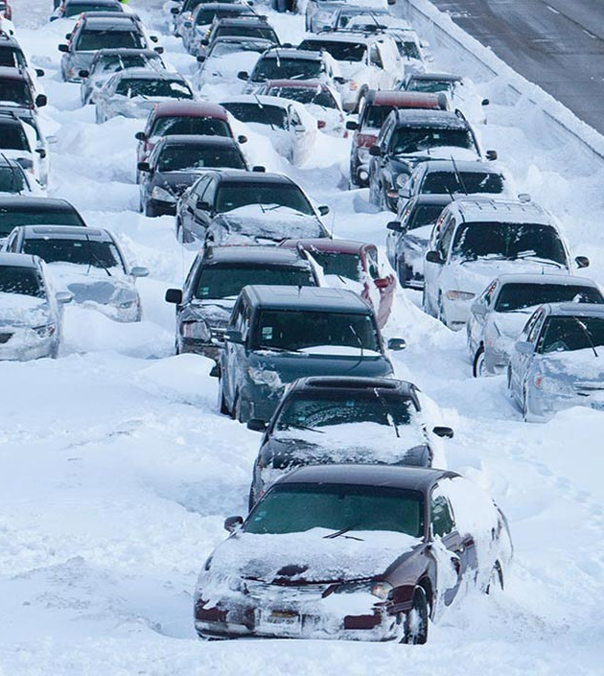
Code Patterns
Build a cognitive recommendation app with Swift
Correlate flight and weather data in an augmented reality mobile app
Create charts, graphs, and maps using open city datasets
Create a simple chatbot with Node.js and Watson Assistant
Improve logistics based on traffic and weather activity to reduce number of people affected
developer.ibm.com/callforcode/resources/traffic-and-weather/

Slide 12

Code Patterns
Analyze industrial equipment for defects
Detect voltage anomalies in household IoT devices
Develop an IoT asset tracking app using Blockchain
Use MQTT to stream real-time data
Analyze device sensor data to take corrective or preventative action automatically
developer.ibm.com/callforcode/resources/preventative-action/

Slide 13
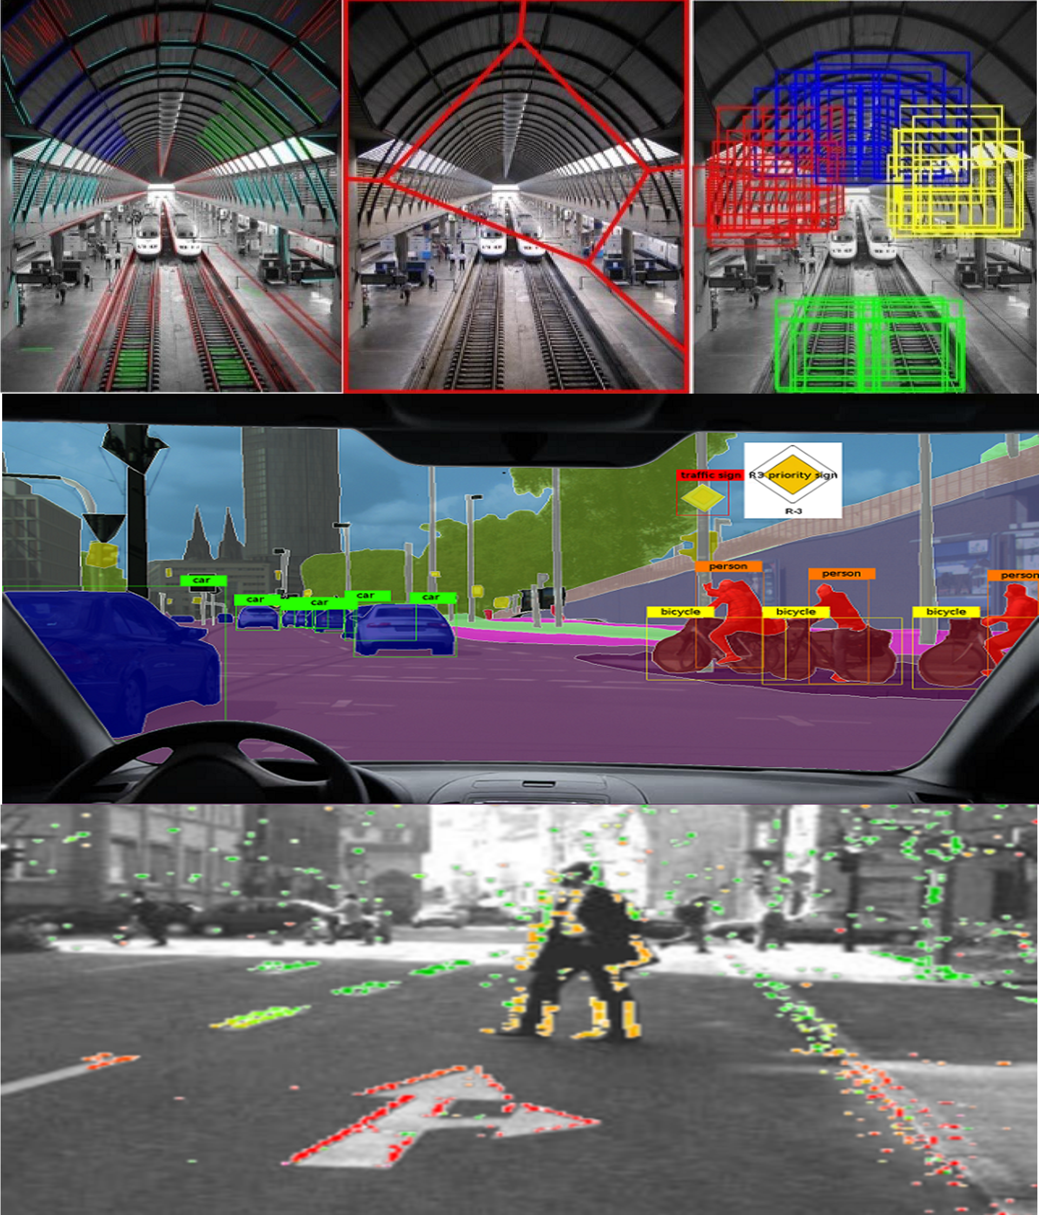
Code Patterns
Build an iOS game powered by Core ML and Watson Visual Recognition
Locate and count items in an image with object detection
Classify vehicle damage images
Deploy Tensorflow on Kubernetes
Use visual recognition to process claims quickly or identify immediate need for aid
developer.ibm.com/callforcode/resources/visual-recognition/

Slide 14
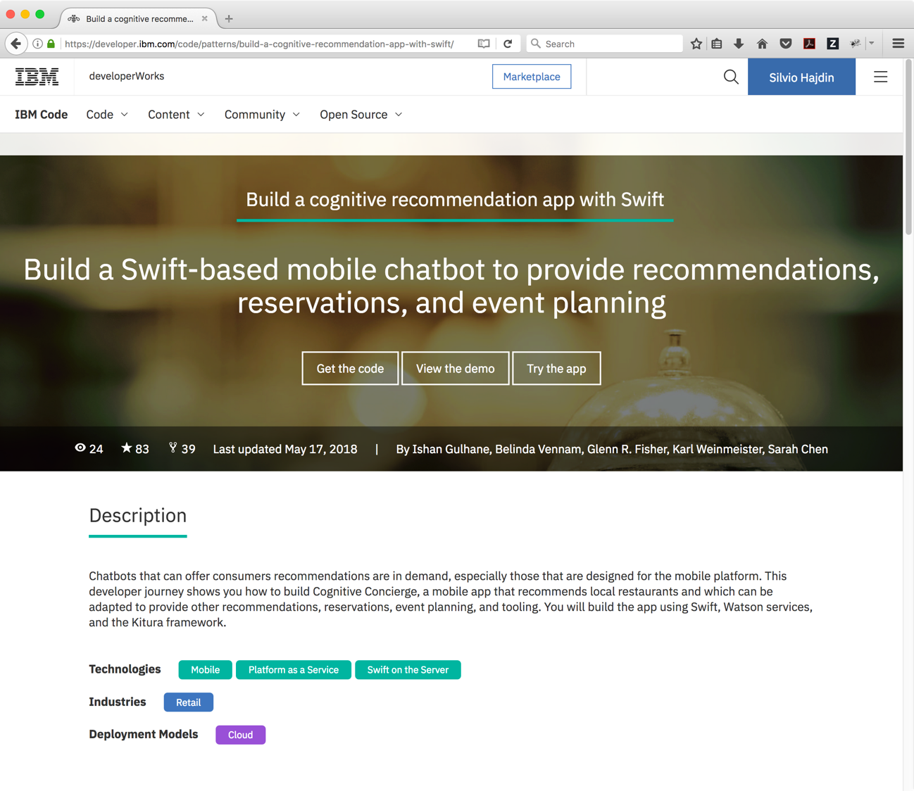
DEPLOY NEW APPLICATIONS QUICKLY WITH CODE PATTERNS, ROADMAPS FOR SOLVING COMPLEX PROGRAMMING CHALLENGES
Notes:
Those Code Patterns will be your primary way to explore working examples of IBM Cloud services. They all have a use case description, GitHub repos, and architecture diagrams.
Beyond the ones that have been highlighted for this competition, there are over one hundred additional code patterns to explore on developer.ibm.com/code

Slide 15
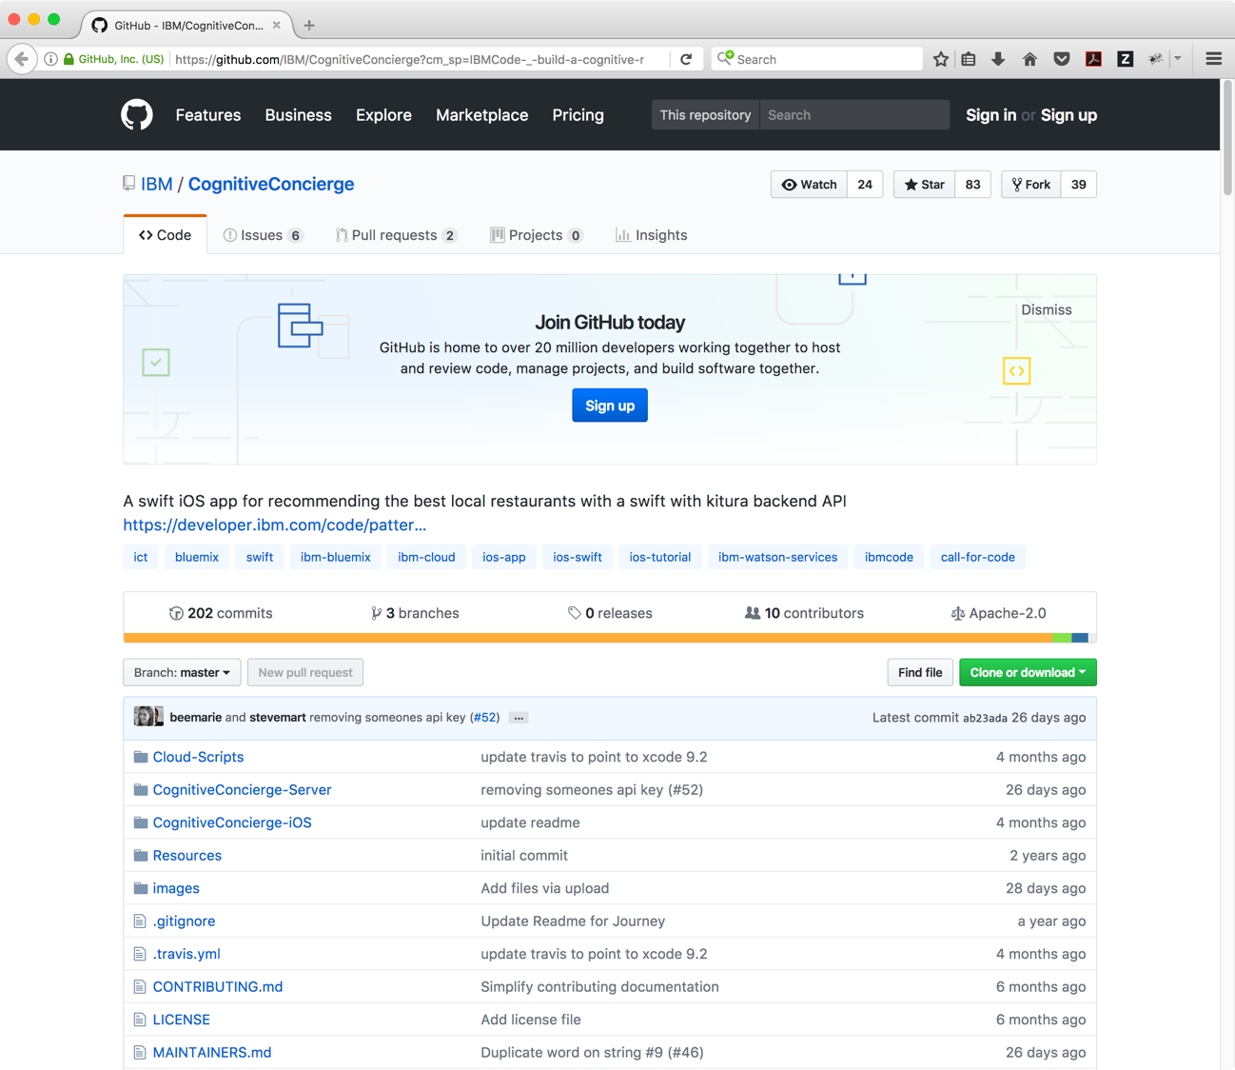
CODE PATTERNS PROVIDE A 360-DEGREE VIEW OF THE UNDERLYING CODE, INCLUDING OVERVIEWS, ARCHITECTURE DIAGRAMS, PROCESS FLOWS, REPO POINTERS, AND ADDITIONAL READING
Notes:
The GitHub repos also have more in depth documentation and many have a one-click deploy to the IBM Cloud option.

Slide 16
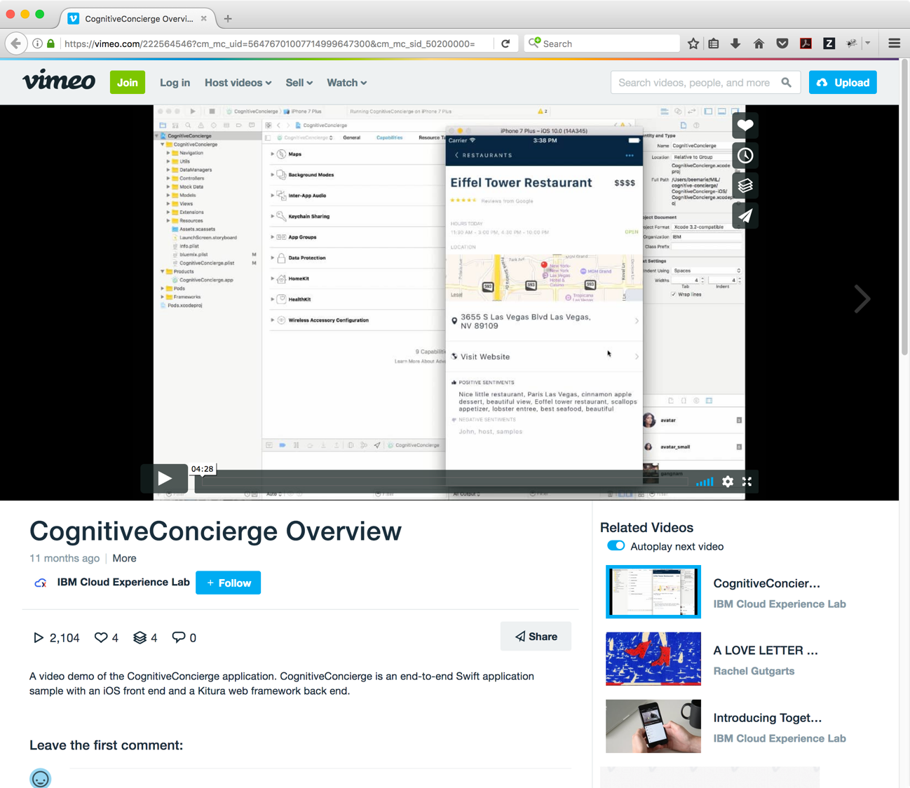
VIEW STEP-BY-STEP INSTRUCTIONAL VIDEOS SHARED BY EXPERT DEVELOPERS
Notes:
And many of them have associated demo videos as well.

Slide 17
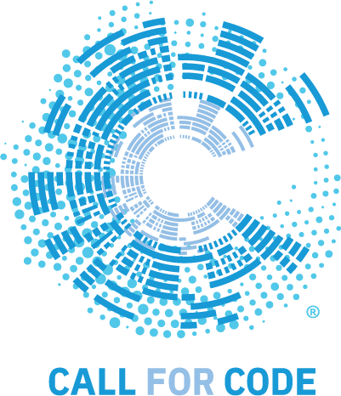
How to start solving the world's largest natural disaster challenges with code
STEP 1:
SIGN UP FOR A FREE IBM ACCOUNT
bit.ly/ibm-acct
GET AN ACCOUNT GRANTING FREE TIER ACCESS FOR AN UNLIMITED TIME.
STEP 2:
DEVELOP WITH CODE PATTERNS
developer.ibm.com/callforcode
USE CODE PATTERNS IN SIX TECH AREAS TO INSPIRE YOUR SUBMISSION
STEP 3:
ENGAGE WITH THE COMMUNITY
ibmcoders.influitive.com
callforcode.slack.com
MEET ADVOCATES, BRAINSTORM IDEAS, FIND A TEAM, HEAR ABOUT UPDATES
STEP 4:
SUBMIT YOUR PROJECT – AUG 31
TBD
SUBMIT YOUR TEAMS AND YOUR PROJECTS FOR OFFICIAL JUDGING
Notes:
Replace the Step 3 link with your LAB / Group slack channel! The slack team shown is for the external challenge.

Slide 18
PRESENTATION AND PLAYBACKS TODAY
No formal judging today..
Hear from peers on your idea, then continue to implement.
Ideas, flow diagrams, model/prototype
Convey a user-centered story with your demonstration
Local prize 1
Local prize 2
Local prize 3
Local prize 4
Local prize 5
Local prize 6
Notes:
For IBM labs:
End of day – What are they supposed to be showing?
Ideas, prototypes, models, flow diagrams

Slide 19
RULES FOR IBMER CHALLENGE
Timeline
June 18th
Announce
June 28– July 23
IBM Lab days
August 31st
Submissions due
October 13th
Awards Concert
Rules:
Up to 5 members per team
IBMers can be a member of only 1 team
One submission per team
Submissions must use at least 5 IBM Cloud services (Cloud Foundry runtime, Cloud Functions, K8s count)
Code written between May 24th and August 31st
IBM employees only (includes interns and supplemental)
Challenge Judging Criteria | Points
Completeness and transferability | 5
Effectiveness and efficiency | 5
Design and usability | 5
Creativity and innovation | 5
Prizes:
Earn 50,000 BluePoints
VIP all-access pass to Call for Code Award ceremony
Free pass to Think 2019

Slide 20

developer.ibm.com/callforcode

